Slide 1

Top Venues in Socioeconomic Clusters
By: Jakub Polanowski

Slide 2
Will Socioeconomics Affect the Types of Venues Present in Clusters of Neighborhoods?
Socioeconomic factors are important features used to gauge the economic well-being of a neighborhood
For a city government, is it possible to get an idea of the types of venues that will be most common within clusters of neighborhoods with similar socioeconomic factors?
Could be used to determine which types of venues would thrive within clusters
What type of venues are most important to residents within the cluster due to their socioeconomic factors
Are there types of venues that are particular affected by high or low socioeconomic status?

Slide 3
Data
Data was source from the City of Chicago Socioeconomics 2017 Database
9 features
2 irrelevant features dropped (community area number’ and ‘percent aged under 18 or over 64
Missing values for any features resulted in the neighborhood being dropped from the dataset
Geolocation data for each Neighborhood obtained by performing geocoding
Arcgis geocoding resolver used
Lists of venues obtained form FourSquare API via the geolocation coordinates of neighborhoods
Radius of 500 ft used to approximately get all venues within the neighborhood

Slide 4
Methodology
Socioeconomic features normalized by converting values to standardized scalars of between 0 and 1
Clusters calculated using K Nearest Neighbors
Number of clusters set to 5
Used K Nearest Neighbors implemented KMeans function from scikit-learn
Model fitted to normalized socioeconomic features
Top 5 Venues Determined for Each Cluster
Cluster Identifier Applied to Each Venue based on which Neighborhood Venue was in
Onehot encoding applied to get counts of each Venue Category
Onehot encoded data grouped by cluster identifier
Top 5 most common venue types columns added to socioeconomic dataset

Slide 5
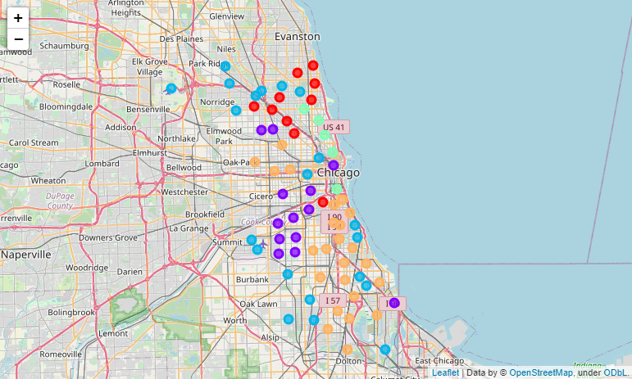
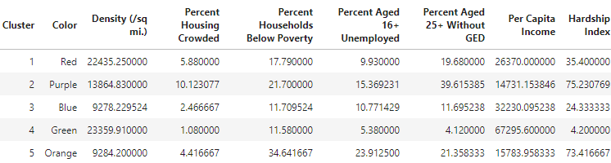
Map Of Clusters

Slide 6
Economic Rankings of Clusters
Cluster 4 is most affluent
Cluster 2 has highest hardship index and lowest per capita income
Cluster 5 has highest percent households below poverty

Slide 7
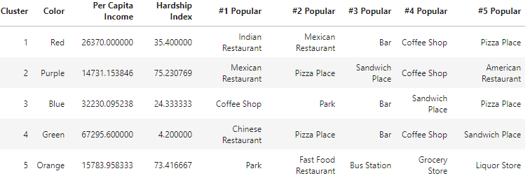
Top Venues in Each Cluster
Poorest two clusters do not have bars within top 5, others do
Cluster with highest % households below poverty only cluster to have Bus Station within top 5 venues
Coffee shops and Pizza Places present within top 5 of 4/5 clusters eachs

Slide 8
Conclusion
Coffee Shops and Pizza Places appear to be approximately universal among cluster, their prevalence appears to be independent of socioeconomic status
Bars and Bus Stations appear to be linked with socioeconomic factors, in which bus stations only appear in the top 5 for the cluster with the highest % households below poverty and bars only in the wealthy to moderately wealthy clusters
Remainder of Venue Types appear to be approximately random and no indication of a trend with socioeconomic factors was observed.

